Slide 1
Problem Statement Worksheet (Hypothesis Formation)
How can the US Department of Transportation reduce fatal roadway crashes by 10% in calendar year 2024? Is the National Roadway Safety Strategy, the President’s Bipartisan Infrastructure Law, and Safe Streets and Roads for All program ($6 Billon over five years) the right approach or government waste?
H
1
NHTSA File Downloads | NHTSA
Context
4
Constraints within solution space
The Biden Administration declared a “crisis on America’s roadways” after the release of the 2021 National Highway Traffic Safety Administration (NHTSA) data showed a 10.5% increase in deaths in motor vehicle traffic crashes in the United States from 2020-2021. Since then, over $6 Billion USD was appropriated in the President’s signature Bipartisan Infrastructure Law to tackle the issue. In 2022 a 0.3% reduction occurred and government forecasts for the first half of 2023 show a potential 3.3% reduction. The National Roadway Safety Strategy (NRSS) established 43 Action Titles to monitor progress from 2022-2023. All of which appear to be qualitative allowing for maximum political bias and maneuvering.
Resources available. This is an academic capstone project with set time constrains and no additional funding for independent data gathering.
5
Stakeholders to provide key insight
Dept. Secretary of US Dept of Transportation – Validate Policy
NHTSA Officials – Key Findings / Datasets Recommendations
News Outlets / Public – Awareness / Further Studies
6
Key data sources
2
Criteria for success
1. Independent assessment of facts and assumptions made in the NRSS using the NHTSA’s own data. Does it target the features that contribute most to motor vehicle traffic crashes?
2. Train a machine learning model on a cleaned NHTSA data set to predict fatalities and forecast the 2023 estimated deaths using feature set from the NRSS and the feature set from my own analysis of the data. Goal is a combination that offers a path to a 10% reduction.
Workbook: NRSS Dashboard (dot.gov)
Implementing the National Roadway Safety Strategy | US Department of Transportation
FastStats - Leading Causes of Death (cdc.gov)
NCSA | Tools, Publications, and Data (dot.gov)
3
Scope of solution space
This initiative will focus on examination of NHTSA data from 1975-2021 and statistics from the National Center for Health Statistics (part of the Centers of Disease Control and Prevention (CDC).
H
D
E
I
P
Notes:
Hypothesis: Create a Hypothesis with an emphasis on SMART principles. (S – Specific, M – Measurable, A – Achievable, R – Realistic, T – Timebound). If you cannot do this, you do not have a good grasp on the business problem.
Context: With context, we have clearly identified the problem at hand and have elucidated on how our initiative may solve this problem, alongside the commercial implications this will have on the business.
Criteria for Success: Clearly defining the criteria for success ensures that the scope of your work is clearly defined and understood. Otherwise, if this isn’t defined – your work will never end which will result in mismatched expectations.
Scope of Solution Space: Scoping out the solution space ensures that the business initiative is SPECIFIC for a certain segment or area. This prevents solutions that have been developed being scaled and applied for all other business units that the solution may not be responsible or scalable for.
Constraints within Solution Space: Looking forward, what are the foreseeable problems we are likely to encounter? Could this be stakeholder resistance? Could this be we don’t have access to the right data?
Stakeholders to provide key insight: Who are the people I need to speak to, to get the answers I need for my data analysis?
What key data sources are required?
Based off my discussions with the key stakeholders – can we clearly list out all the data sources we need so we can make a highly targeted request as opposed to a scatter-gun approach where we ask for a bit of everything?

Slide 2
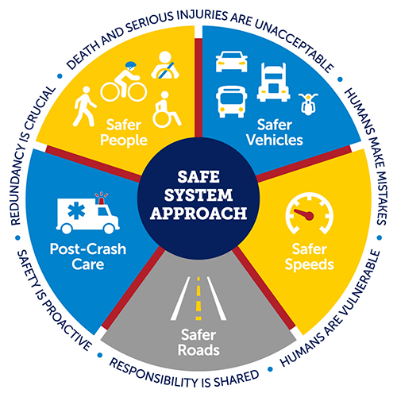
According to the National Highway Traffic Safety Administration (NHTSA), there were an estimated 42,915 deaths in motor vehicle traffic crashes in the United States in 2021, which is a 10.5% increase from the previous year ¹. This is the highest number of fatalities since 2005 and the largest annual percentage increase in the Fatality Analysis Reporting System’s history
https://www.nhtsa.gov/press-releases/early-estimate-2021-traffic-fatalities
Heart disease: 695,547
Cancer: 605,213
COVID-19: 416,893
Accidents (unintentional injuries): 224,935
Stroke (cerebrovascular diseases): 162,890
Chronic lower respiratory diseases: 142,342
Alzheimer’s disease: 119,399
Diabetes: 103,294
Chronic liver disease and cirrhosis : 56,585
Nephritis, nephrotic syndrome, and nephrosis: 54,358
https://www.cdc.gov/nchs/fastats/leading-causes-of-death.htm
2022: 42,795 0.3% decrease
2023: 1st Half 19,515 estimated (<3.3% from 2022 mark)
Our Nation's Roadway Safety Crisis (arcgis.com)
Implementing the National Roadway Safety Strategy | US Department of Transportation
Workbook: NRSS Dashboard (dot.gov)
43 Action Titles in NRSS 2022-2023
U.S. Transportation Secretary Pete Buttigieg Announces Comprehensive National Roadway Safety Strategy | US Department of Transportation

Slide 3
